Slide 1
CENTRAL PROCESSING UNIT (CPU)
GROUP - 4
K M Hasibudula (ROLL 01115)
Lt Col Jeenia Haque (ROLL 01116)
Mohammad Towhiduzzaman (ROLL 01117)
Md. Nasarul Hasan (ROLL 01118)
PRESENTED BY
Lt Col Jeenia Haque
1

Slide 2
SEQUENCE
Introduction
Evolution of processor
Need to know Information
Structure of processor
How a processor works?
Future Expectation
Interactive Session
2

Slide 3
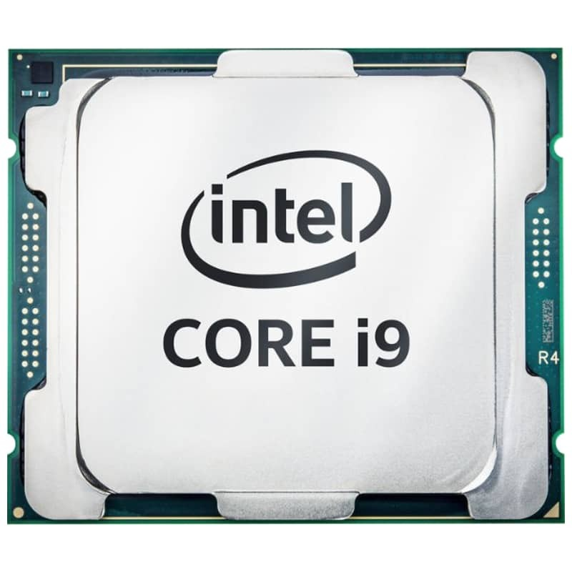
introduction
A processor or Central Processing Unit (CPU) is an electronic circuit that can execute computer programs
Logic circuitry that responds to and processes the basic instructions
Analyzes data and controls data flow in a computer
It is the brain of the computer
3

Slide 4
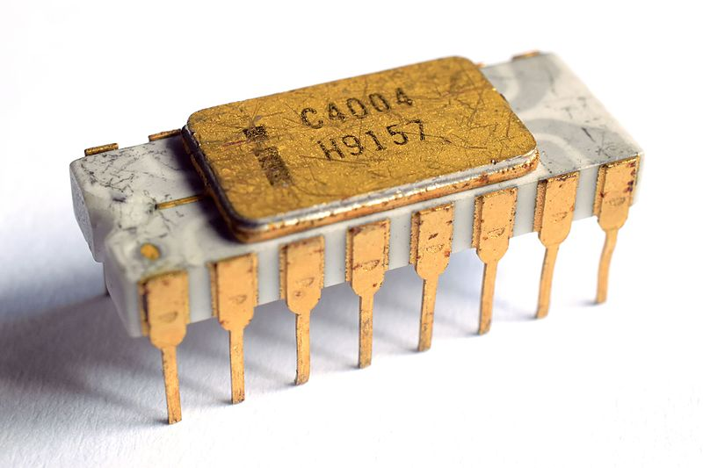
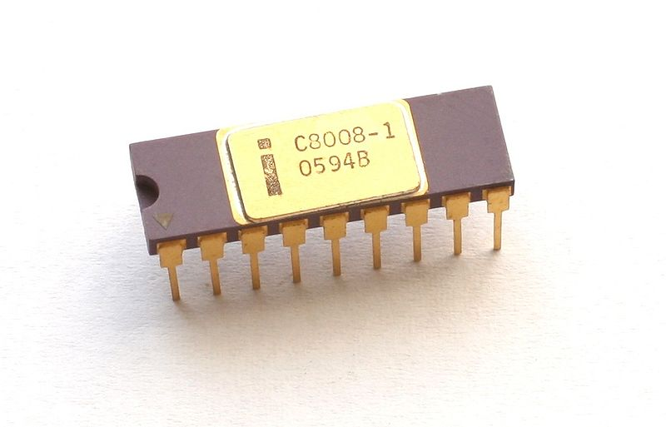
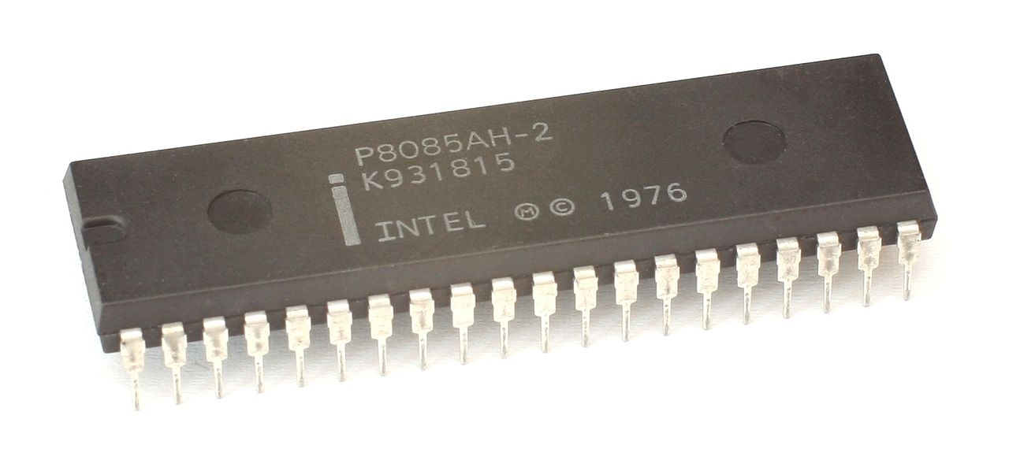
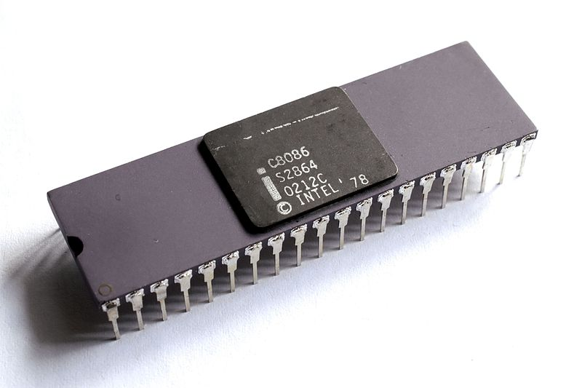
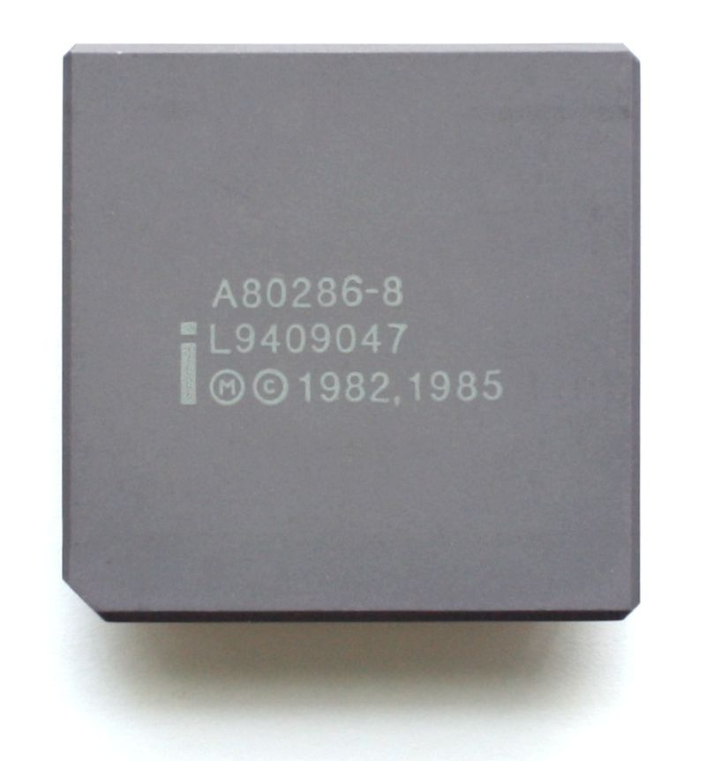
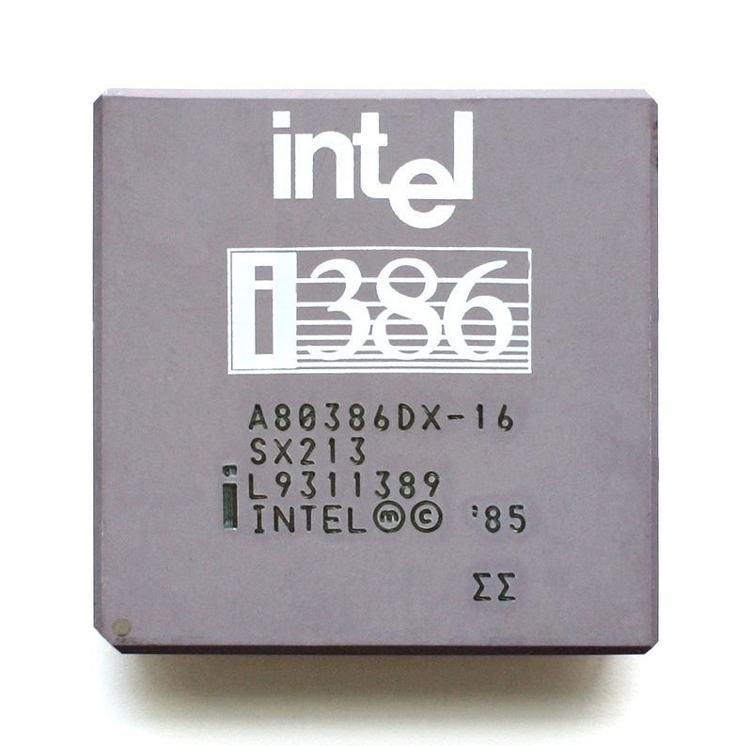
evolution of processor
Intel 4004 Introduced: November 15, 1971 Clock Speed: 400 -800 kHz Data Width: 4 Bit Package: 16 pin DIP Transistors: 2,25 | Intel 8008 Introduced: April 1972 Clock Speed: 200 kHz to 800 kHz Data Width: 8 Bit Package: 18-pin DIP Transistors: 3,500
Intel 8085 Introduced: March 1976 Clock Speed: 3, 5 and 6 MHz Data Width: 8 Bit Package: 6,500 Transistors: 40-pin DIP | Intel 8086 Introduced: June 1978 Clock Speed: 5 MHz to 10 MHz Data Width: 16 bits Package: 40 pin DIP Transistors: 29,000
Intel 80286 (The last 16 bits CPU) Introduced: February 1982 Clock Speed: 6 MHz to 12 MHz Data Width: 16 bits Package: 68-pin PLCC Transistors: 134,000 | Intel 80386 (The first 32 bits CPU) Introduced: October 1985 Clock Speed: 16 MHz to 33 MHz Data Width: 32 bits Package: 132-pin PGA Transistors: 275,000
4
Source: https://www.wikipedia.org
5

Slide 5
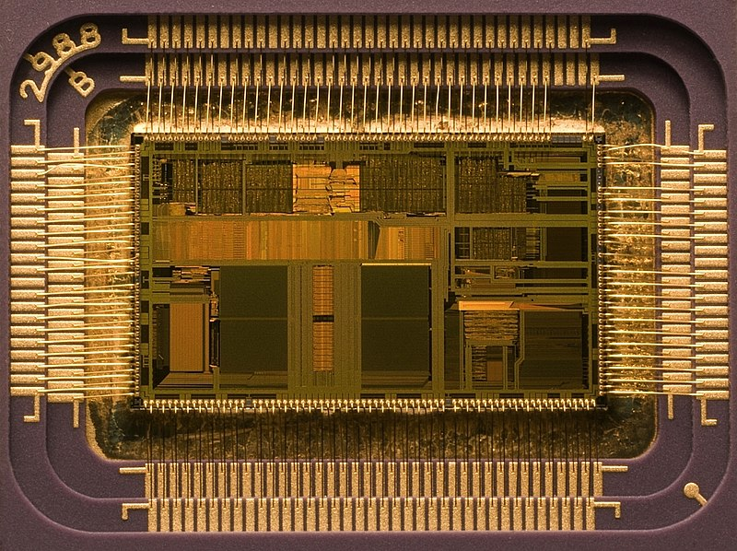
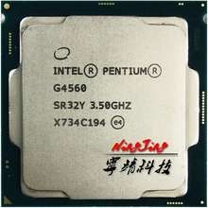
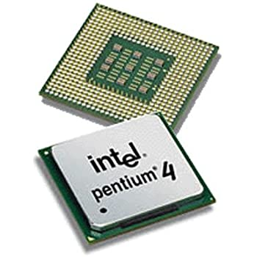
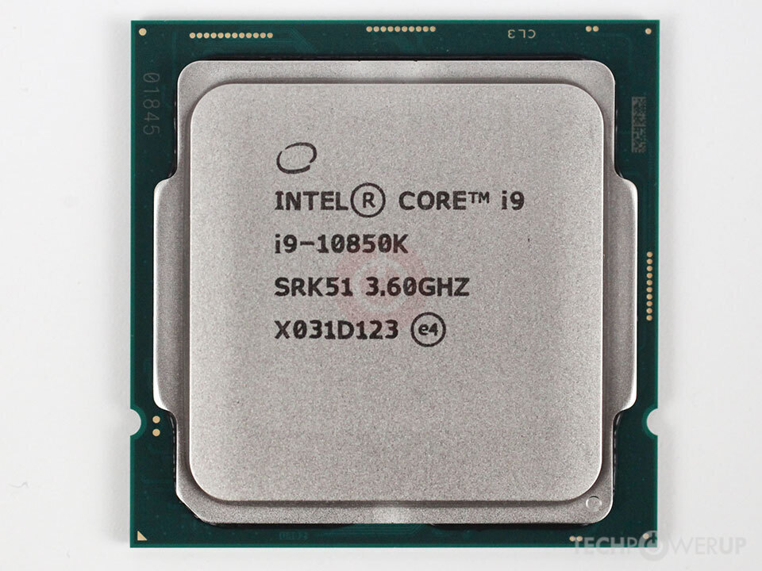
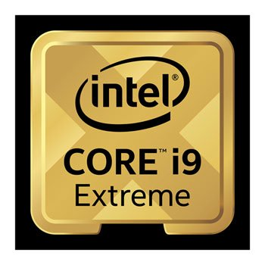
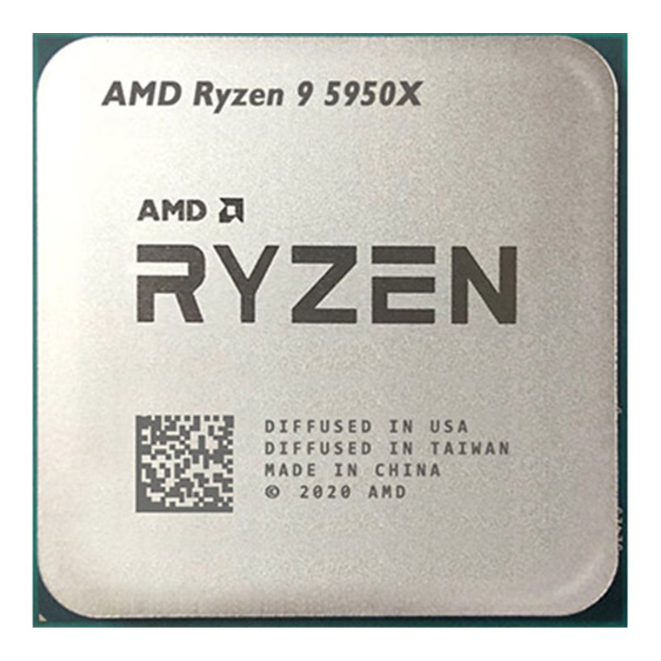
Continued…
evolution of processor
Intel 80486 Introduced: April 1989 Clock Speed: 16 MHz to 100 MHz Data Width: 32 bits Package: PGA (Socket 1, 2, 3) Transistors: 1.2 Million | Intel Pentium Introduced: November 1993 Clock Speed: 60-300 MHz Data Width: 32 bits Package: Socket 4 Transistors: 3.2 Million
Intel Pentium Pro/ II / III /4 Introduced: November 1985-2000 Clock Speed: 166 MHz- 3.6 GHz Data Width: 32 bits Package: Socket 4 - LGA 775 Transistors: 5.5-28 Million | Intel Core i9-10850K 20M Cache up to 5.20 GHz 20 MB Intel Smart Cache 10 Cores, 20 Threads 5.20 GHz Max Turbo Frequency 10th Generation
Intel Core i9-10980XE Extreme 20M Cache up to 5.20 GHz 24.75 MB Intel Smart Cache Cache 18 Cores 36 Threads 4.60 GHz Max Turbo Frequency EX-Extreme performance and mega-tasking, Unlocked | Ryzen™ 9 5950Xs Model: Discrete Graphics Card Required CPU Cores 16 Threads 32 Max Boost Clock up to 4.9GHz Base Clock 3.4GHz Default TDP / TDP 105W
Source: https://www.wikipedia.org
5

Slide 6
Need to know information
Position: The processor is placed on the motherboard, in the processor socket
Clock speed: Clock speed is a measure of how quickly a computer completes basic computations and operations. It is measured as a frequency in hertz
Core: Hardware unit in the processor architecture that can execute instructions sent to it
Hyper Threading: Virtual core and work like a real core inside CPU
Cache: First block of RAM which interact between the main memory and CPU using cache controller chip
8

Slide 7
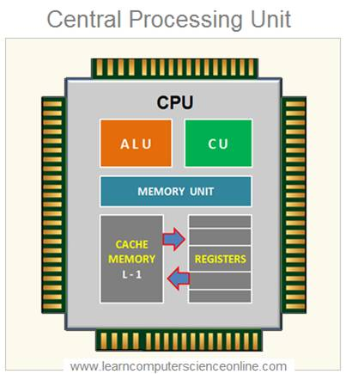
structure of processor
Arithmetic and Logic Unit (ALU): Carries out the logical, algebraic or any type of calculations
Control Unit: Manages the fetching, decoding and execution of the instructions
Register: A memory location within the actual processor that work at very fast speeds
Internal Buses: Transmit information from one place to another
Source: https://computersciencewiki.org/index.php/Architecture_of_the_central_processing_unit_(CPU)
6

Slide 8
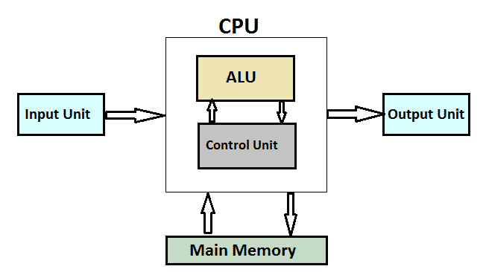
How a processor works?
Fetch: The processor retrieves program instructions from memory
Decode: The instruction is broken down into parts
Execute: CPU performs the operation implied by the program instructions
Write back: The Processor writes back the results of execution, to the computer's memory
Source: https://www.it4nextgen.com/what-is-a-cpu-central-processing-unit/
7

Slide 9
Future expectation
Smaller
Cheaper
High speed
Reliable
9

Slide 10
INTERACTIVE SESSION
10

Slide 11
THANK YOU
11

